Slide 1
CONVERSION OF ENGLISH
TEXT FROM WRITTEN TO SPOKEN FORM

Slide 2
Motivations
Kaggle competition named “Google Text Normalization”
Challenge launched a year ago

Slide 3
Problem Definition
Given a set of data of english words, convert these words into spoken form.
Have to automate the process of developing text normalization i.e applying models on tokens of grammars via machine learning.

Slide 4
Aim
To convert texts in written from to spoken form.
Example:
150 lb to one fifty pound
26 Aug, 2016 to twenty sixth august twenty sixteen
1994 to nineteen ninety four

Slide 5
Choices Explored
DICTIONARY LOOK UP TECHNIQUE
RULE BASED APPROACH
STATISTICAL MACHINE TRANSLATION (SMT) APPROACH
SEQ TO SEQ
LSTM
LSTM AND SEQ TO SEQ

Slide 6
Assumptions Made
Sentences wouldn’t be longer than 100 characters.
Training dataset does not have very long texts, whose meanings might depend on previous contexts.
All the sentences should be pure english language i.e if somewhat is frenched words then “cat” can be interpreted as “le chat”

Slide 7
Assumptions Made
Assumptions are realistic and can be removed without invalidating approach, if we have capable hardware.
For training the model, we will have very few long sentences and text normalisation mostly depends on current context.
It is independent of previous long contexts.

Slide 8
Constraints
To achieve good accuracy we should must have at least of 6 lac sample sentences to train on.
To train model over such large sized dataset, A hardware with following specifications will be needed :
NVIDIA GPU K80
INTEL I7 OR INTEL XEON CPU

Slide 9
Constraints
32GB RAM
120GB SSD
Following software architecture will be required:
UNIX OPERATING SYSTEM
TensorFlow 1.0
Compatible CUDA module with Tensorflow 1.0 e.g. 9.0 or 10.0.

Slide 10
Dataset
The dataset is derived from Wikipedia regions which could be decoded as UTF8. The text is then divided into sentences and through the Google TTS system’s Kestrel text normalization system to produce the normalized version of that text.
We have total of 600K data but model is trained over 20K data.

Slide 11
Tools and technology used
Python : To run all the code
Tensorflow : For training large neural network model (backend)
Keras : Run over the top of tensorflow (frontend)
Matplotlib : For visualizing the result and various plots.
Numpy : For algebraic computing over the word vector.
Scipy : For scientific computing like optimization, preprocessing and special function.

Slide 12
Output and Results
Read original text from dataset and ignore plain texts:
Output :
310919
sentence_id before after
1 2006 two thousand six
1 IUCN i u c n
3 2007 two thousand seven

Slide 13
Output and Results
Pre-Process text in dataset :
Separate input and target sentences
Assign each character and each word token a unique int id
Extract the exact word from sentences
Convert each word in form of One-Hot-Encoding

Slide 14
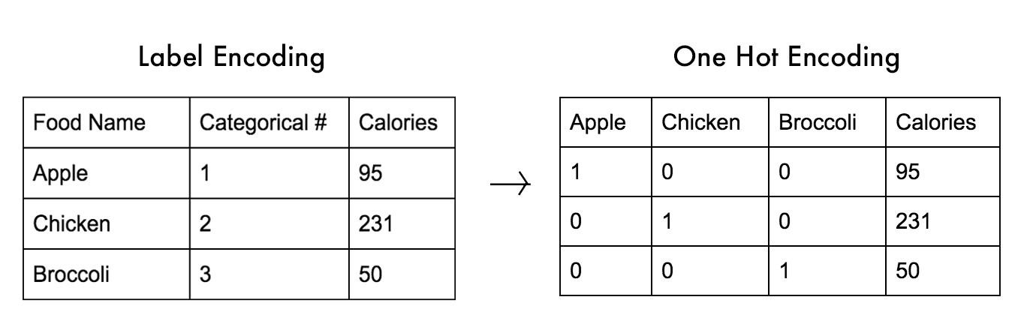
One-Hot-Encoding
A process of conversion of categorical variables into numeric variables.

Slide 15
Output and Results
Compute train and validation loss and update model parameters over each epoch using following built in classes and methods:
LSTM : RNN based learning layer
rmsprop for optimization : This function called each time to update weights of parameters of LSTM
categorical_crossentropy : This function is called after each epoch to calculate training and validation loss

Slide 16
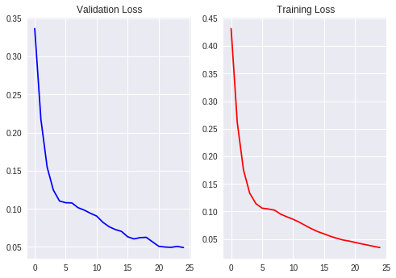
Output and Results
A statistical view of losses:

Slide 17
Output and Results
Predict normalized text :
Input sentence: 1595
Decoded sentence: fifteen ninety five
-
Input sentence: "August 16, 2005"
Decoded sentence: august twenty first twenty fifteen

Slide 18
Conclusion
The success of our simple LSTM-based approach suggests that it should do well on many other sequence learning problems, provided they have enough training data. Due to hardware restriction we were not able to train our model over large dataset (over 100 K),so there are some wrong predictions also, specially in conversion of sentences having dates in textual form. But we trained upto 20K sentences. However with very small dataset it gave one out of every five predictions correct with 100 percent accuracy.

